Slide 1
Reverse a Linked List

Slide 2
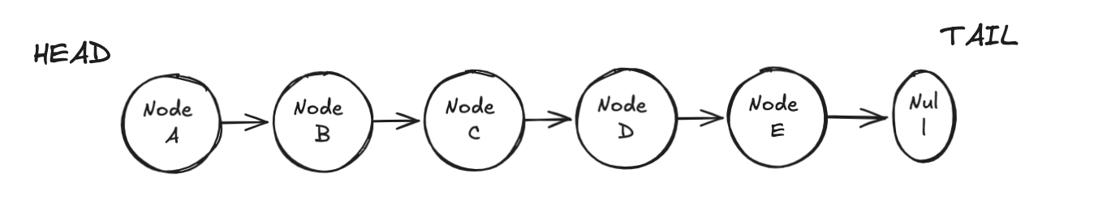
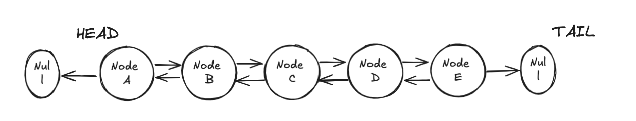
What is a Linked List?
A linked list is consisted of List Nodes that have a value and a reference to the next Node.
There are two types of linked lists a Single Linked List or a doubly Linked list pictured below

Slide 3
What to learn
Reversing a linked list is a simple problem but there are so many things to learn from it. By the end of this lesson you should be able to:
Pointer manipulation
Edge case handling and debugging
Data structure traversal: Recursion vs Iteration
What’s a call stack?
Space and time complexity trade-offs

Slide 4
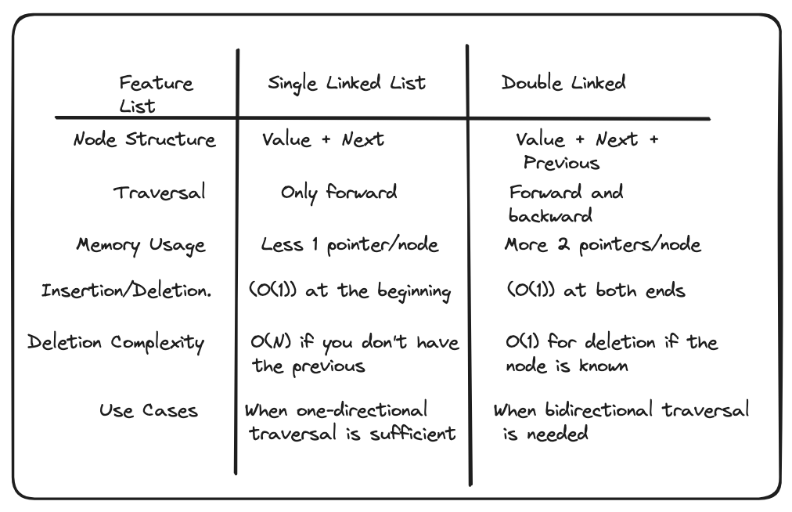
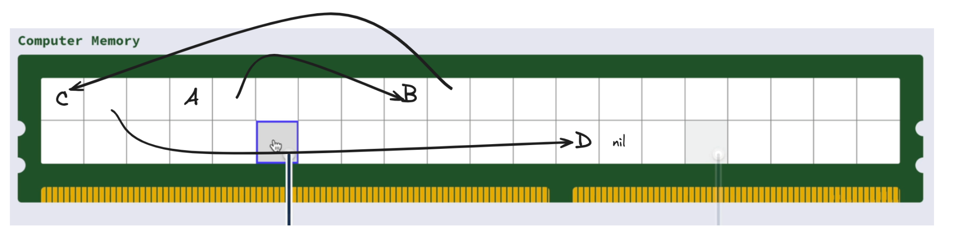
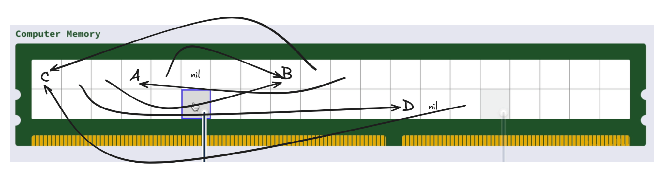
Trade offs
Why not use a doubly linked list every time as opposed to using a single linked list
Single Linked List
Double Linked List

Slide 5
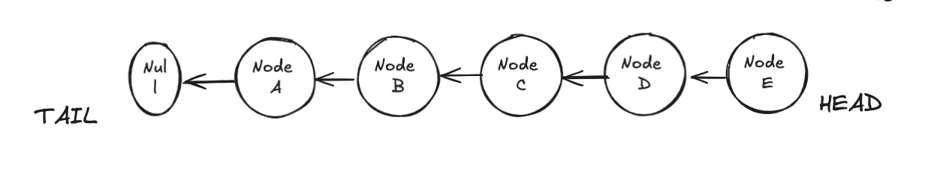
Specs
Write a program that:
takes the head of a singly linked list
reverses the list
returns the new head of the reversed list

Slide 6
Blank for problem

Slide 7
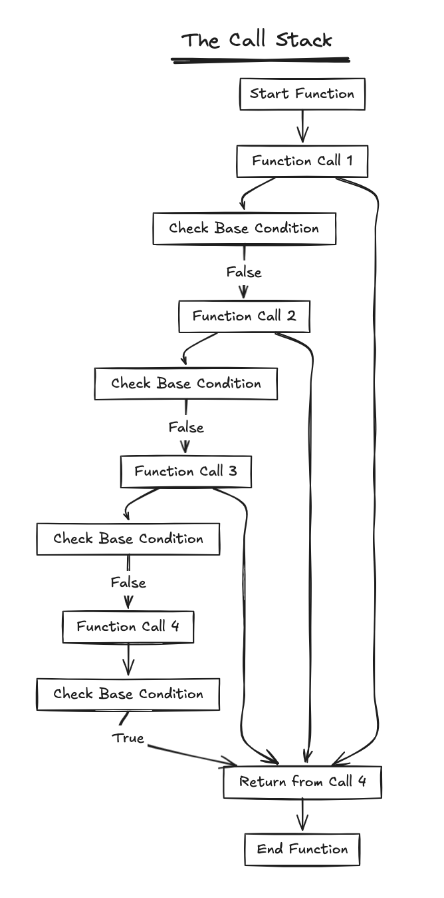

Complexity
Iterative Approach
Time: O(N)
Space: O(1)
Recursive Approach
Time: O(N)
Space: O(N)

